Slide 1

Auto-IA Workshop HMTM Hannover
Automatic Content Analysis
Introduction
Gregor Wiedemann | g.wiedemann@leibniz-hbi.de
Media Research Methods Lab
Leibniz-Institute for Media Research | Hans-Bredow-Institut
Andreas Niekler | aniekler@informatik.uni-leipzig.de
Abteilung Automatische Sprachverarbeitung, Institut für Informatik
Universität Leipzig

Slide 2

Course plan
Lectures
  Text as data / pre-processing
  Lexicometrics: Frequency, Keyness, Co-occurrence
  Topic Modelling
    Berechnung
    Evaluierung / Modell-Selektion
Tutorials: 3+ work sheets
Hands-On: Corona News Coverage

Slide 3
1. Text processing

Slide 4
Text Mining
Text Mining (TM) is a set of "computer based methods for a semantic analysis of text that help to automatically, or semi-automatically, structure text, particular very large amounts of text"
(Heyer 2009, p.2)
TM combines
  linguistic knowledge
  statistical knowledge

Slide 5
Text as data
symbol ← meaning
  character: linguistic unit (meaning representation)
    豊δ Α ♣ …
  glyph: graphical representation of a symbol
    a ← {a a a a A A A A}
alphabet: fixed set of characters
  {a, b, c, d, e, ...}
encoding
  unambigous assignment of characters from an alphabet to {bit patterns, octets, ...}
  standards („a“): ASCII (61), ISO-8859-1 (61), UTF-8 (U+0061), …

Slide 6
Text as data
String: concatenation of alphabet elements
  „Hello world!“, „“, „00010111100010101“, „To be or not to be...“
  essential, elementary data type in computer linguistics
  common operations: e.g.
    concatenation: „Hello“ + „World“ + „!“ → „Hello World!“
    splitting: split(„Hello World!“, „ “) → {„Hello“, „World!“}
    case conversion: uppercase(„Hello“) → „HELLO“
    substring: substr(„Hello“, start = 0, length = 4) → „Hell“
Document: compound data type
  (collection of) strings (e.g. title, body) [+ Metadata]
Corpus: collection of documents

Slide 7
Text as data
Type (cp. class)
  (abstract) string representing a meaningful concept, e.g. words
Token (cp. object)
  (concrete) string as instance of a meaningful concept
In disciplines such as knowledge representation and philosophy, the type–token distinction is a distinction that separates a concept from the objects which are particular instances of the concept.“
(Wikipedia → Type–token distinction)
disciplines
distinction
concept
...
Vocabulary
  complete set of all types occuring in a [document | collection]

Slide 8
Text as data
Transformation of text into numerical objects
Transformed objects → Data Mining
  process of discovering patterns in large data sets
1
2
2
1 2 4 ...
2 0 0 ...
2 5 1 …
disciplines
distinction
concept
...
List of strings
vector
matrix

Slide 9
NLP piplines
PIPELINE: application of different data manipulation procedures in row
  preprocessing
  actual analysis
  output format
e.g.
data reader
filter
sentences
tokens
sentiments
Every single step involves a lot of parameters
→ What are best parameter settings?
→ Reproducibility?
data writer

Slide 10
7. TEXT MINING PROCEDURES

Slide 11
Vector Space Model
Idea: Encode textual
  documents in vectors
  collections in matrices
data = event counts
dimensionality of vector space
  |vocabulary of collection|
D1: Kim is leaving home.
D2: Kim is at home.
D3: Karen is leaving.
Kim | is | leaving | home | . | at | Karen
1 | 1 | 1 | 1 | 1 | 0 | 0
1 | 1 | 0 | 0 | 1 | 1 | 0
0 | 1 | 1 | 0 | 1 | 0 | 1

Slide 12
Document-Term-Matrix
  may get very large!
  events: frequency counts of word types in each document
  bag of words
  very sparse (contains mostly zeros)
  variations:
    binary event counts
    paragraphs as documents
    sentences as documents
    additional n-grams (n > 1) as events
    ...
1 | 0 | 5 | 1
0 | 0 | 0 | 2
1 | 3 | 0 | 1
0 | 0 | 0 | 0
n documents
m word types
n – size of collection
m – size of vocabulary

Slide 13
Stop words
stop words = list of words considered as no meaningful for specific NLP task
→ can be filtered out of global vocabulary to reduce data / improve performance
example:
  DTM^{50x2103}, 6198 tokens
  remove 78 sw (– 4%) →
  DTM^{50x2027}, 4801 tokens (– 22%)
am among amongst amoungst amount an and another any anyhow | anyone anything anyway anywhere are around as at back be | became because become becomes becoming been before beforehand behind ...
N between ~100 … ~1000

Slide 14
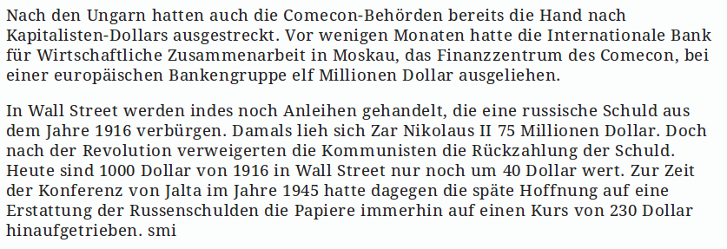
Stop words

Slide 15
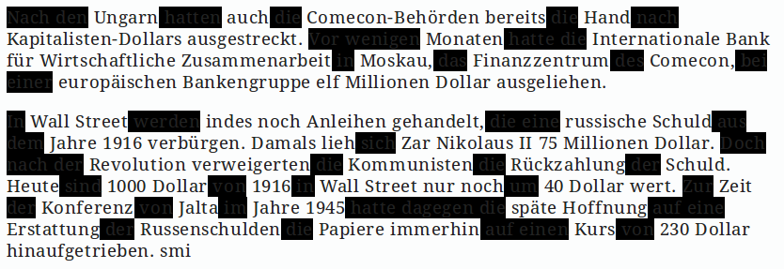
Stop words

Slide 16
Pruning
Pruning = filtering the vocabulary of a collection by minimum / maximum thresholds of occurrence
very useful preprocessing step to reduce vocabulary size:
  Count occurrence of types in the complete collection
  keep only those terms which occur above / below a defined threshold
Caution: distribution of language data → see chapter „frequency analysis“
term frequency:
  sum all term occurrences in all documents
  filter terms which occur e.g.
  count(term) > 1 AND count(term) < 100
document frequency:
  for each term count number of documents in which it is contained
  allows for filters like: terms which occur e.g. in
  more than 99% AND
  less than 1%
  of documents

Slide 17
Unification: Stem vs. Lemma
Unification:
  observation: similar semantic types share similar orthographic forms
  -ion
  -ions
  connect -ive
  -ed
  -ing
  Idea: map variants to reduced form
    → reduce vocabulary
    → reduce data sparsity
Two methods:
  Stemming: cut of endings by language specific rules
  Lemmatization: mapping of types to linguistic its lemma by dictionary lookup (external resource)

Slide 18
Stemming
Standard appraoch: Porter Stemmer (1980) / Snowball
separation of suffixes by rules, e.g.
  SSES → SS caresses → caress
  IES → I ponies → poni
  (if m>1) EED → EE feed → feed
  agreed → agree
Problems:
  overstemming: artificial ambiguity
    {organization, organ} → organ
  understemming: unification fails
    European → european, Europe → europ
m = number of syllables

Slide 19
Lemmatization
Lookup of canonical / dictionary form
usually retrieved by long dictionary files which contain
  inflected_type lemma_type
  European Europe
  Europe Europe
  Organizations Organization
Problems:
  getting external resources (e.g. ASV Leipzig list of > 600.000 type-lemma-relations for German)
  incomplete lists

Slide 20

Example
McLean Industries Inc's United
States Lines Inc subsidiary said it has agreed in principle to
transfer its South American service by arranging for the
transfer of certain charters and assets to <Crowley Mariotime
Corp>'s American Transport Lines Inc subsidiary.
U.S. Lines said negotiations on the contract are expected
to be completed within the next week. Terms and conditions of
the contract would be subject to approval of various regulatory
bodies, including the U.S. Bankruptcy Court.
PREPROCESSING
- lowercase
- remove punctuation
- remove stop words
- stemming
- strip white spaces
mclean industri inc united
st line inc subsidiari said agre principl
transfer south american servic arrang
transfer certain charter asset crowley mariotime
corp american transport line inc subsidiary
line said negoti contract expected
complet within next week term condit
contract subject approv various regulatory
bodies includ bankruptci court

Slide 21
Sentence detection / Tokenization
→ Essential preprocessing step!
Badly tokenized text data may lead to bad results
frequent errors:
  intra-word dashes: 'front-end' → 'front end' OR 'front-end'
  quotation marks '„Hello“' → '„ Hello “' OR '„Hello“'
  dots for abbreviation: 'Mr.' → 'Mr .' OR 'Mr.'
  colon / semicolon: 'Monday' → 'Monday:' OR 'Monday :'
  apostrophe:
  „O'Neill“ → „Neill“ OR „ONeill“ OR „O'Neill“ OR „O ' Neill“ OR „O' Neill“
  „aren't“ → „aren t“ OR „aren't“ or „arent“ or „are n't“

Slide 22
Part-of-Speech
Task PoS-Tagging = Assign a word type label to each token in a sentence
  The cat barks at the dog .
  DET NN VF PRE DET NN $
Ideal task for machine learning classifiers on annotated training data!
  e.g. Conditional Random Field classifier: most probable sequence of outcome labels to an input sequence
label sets are called „tag sets“ → different sets for different languages / tasks
  English: Penn Treebank POS tags (36 labels)
  German: STTS Stuttgart/Tübingen Tagset (57 labels)
  Translingual: Universal POS tags (17 labels)

Slide 23
Summary
Linguistic Preprocessing
  shall reduce / unify data for application specific purpose
  may contain various steps in row
    Encoding
    Spelling correction
    Removing uninformative data: noise, duplicates, stopwords, low/high frequent terms (pruning), dictionaries
    Sentence detection, tokenization, Part-of-Speech tagging
    Unification: punctuation, capitalization, stemming, lemmatization
  best setup usually has to be identified experimentally (or by experience)
  caution: order of steps may influence result!

Slide 24
2. Machine Learning

Slide 25
Machine Learning
Definitions
  “[Giving] computers the ability to learn without being explicitly programmed” – Arthur Samuel
  “A computer program is said to learn from experience E with respect to some class of tasks T and performance measure P, if its performance at tasks in T, as measured by P, improves with experience E” – Tom M. Mitchell
Common foundations
  Probability Theory
  Decision Theory (making “good” decisions based on data)
  Optimization (optimize model of data based on decision objective)
independent of application domain

Slide 26
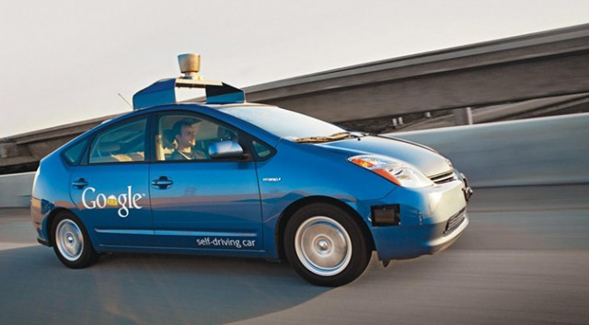
Application domains of ML
Autonomous driving
Medical diagnosis
Network security
...
Textmining and NLP:
  Linguistic preprocessing: POS-Tagging, Parsing
  Modelling Language Semantic
    category classification
    clusters of (latent) meaning

Slide 27
Machine learning for NLP
ML
supervised
(classification)
unsupervised
(clustering)
individual
proportional
VSM
probabilistic
topic models
dimensional
scaling
Naive
Bayes
SVM
ReadMe
k means
LDA
wordfish

Slide 28
Machine learning for NLP
ML
supervised
(classification)
unsupervised
(clustering)
individual
proportional
VSM
probabilistic
topic models
dimensional
scaling
Naive
Bayes
SVM
ReadMe
k means
LDA
wordfish

Slide 29
Clustering
Cluster analysis:
  „task of grouping a set of objects in such a way that objects in the same group (called a cluster) are more similar (in some sense or another) to each other than to those in other groups (clusters)“ [Wikipedia]
Motivation in content analysis:
  identifying similar / (quasi-)duplicate documents / parts of text
  splitting a collection of documents into groups
    thematic
    time periods
  identifying groups of related terms
  placing documents on an ideological scale

Slide 30
Topic Models

Slide 31
Topic Models
Class of probabilistic graphical models which infer semantic coherences from large text collections as latent variables
  Latent variables = topics
Background assumptions
  Bag-of-words model
  Generative process (1. document author, 2. draw topic mixture, 3. draw terms from topics → document)
2 posterior distributions
  θ : Documents = mixtures of topics
  β : Topics = probability distributions over terms
Variety of models (Blei 2012): e.g.
Latent Dirichlet Allocation (Blei et al. 2003)
Correlated Topic Models (Blei & Lafferty 2007)
Hierarchical Dirichlet Process (Teh et al. 2006)
Author-Topic Model (Rosen-Zvi et al. 2004)
...

Slide 32
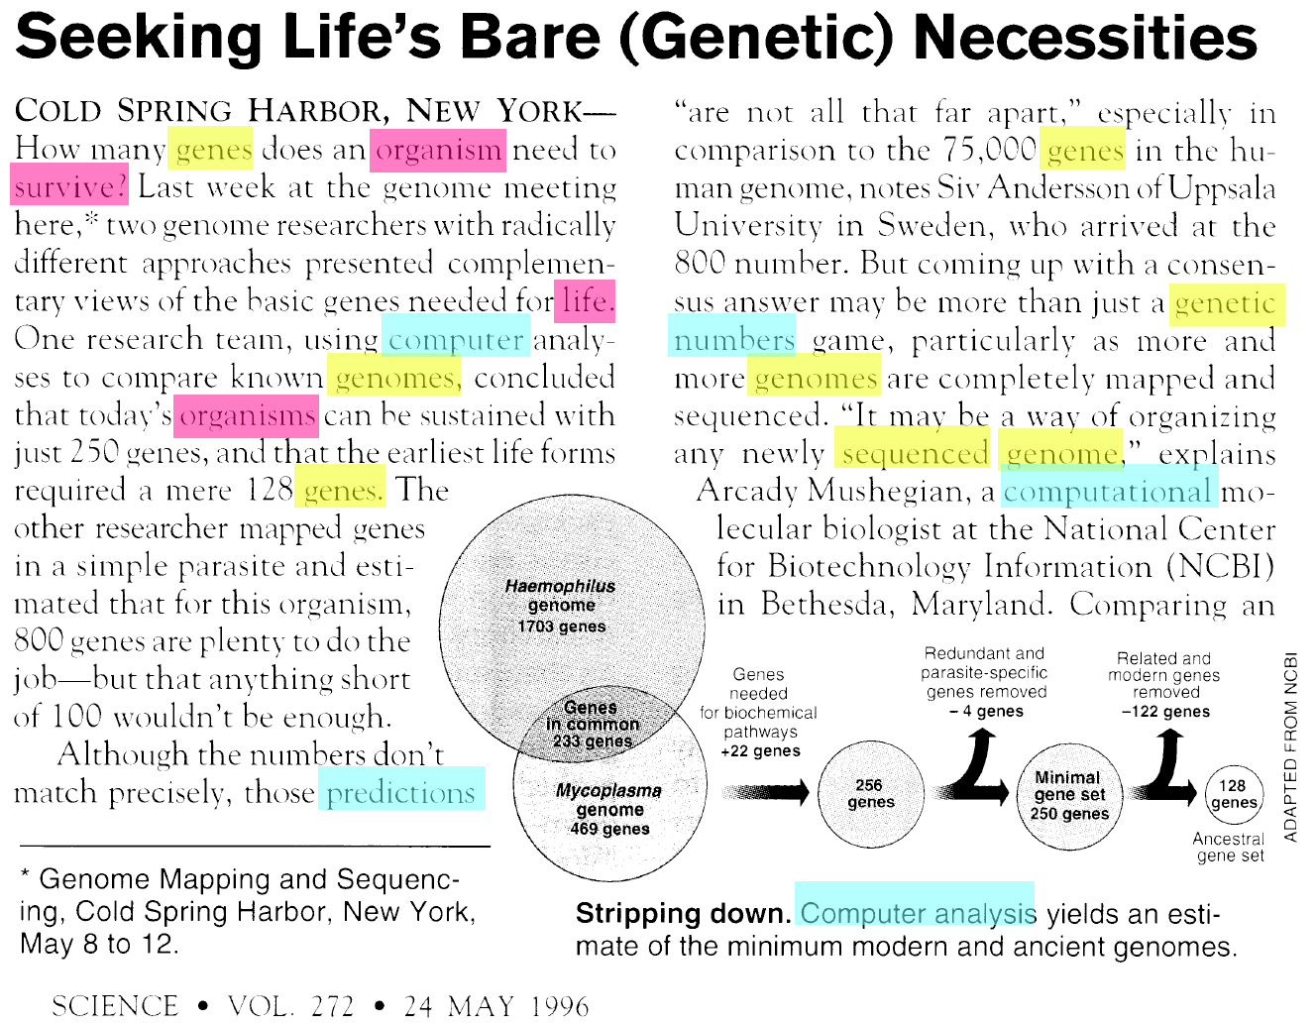
Latent Dirichlet Allocation (LDA)
Assumptions:
1. Documents are mixtures of topics
2. Topics are distributions over terms

Slide 33
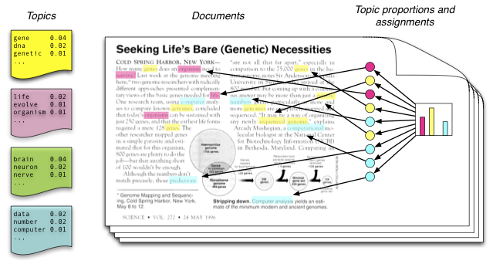
Latent Dirichlet Allocation (LDA)
Model assumptions
every topic is represented by a distribution over terms
every document is represented by a distribution over topics
generative process: for every document → draw a topic distribution → for each topic → draw a term

Slide 34
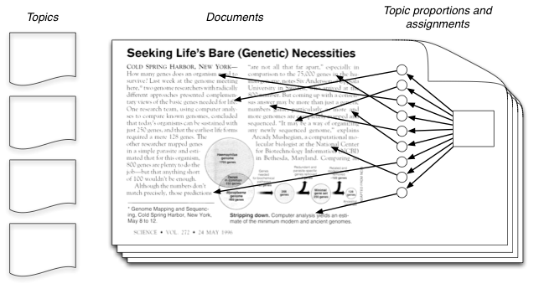
Latent Dirichlet Allocation (LDA)
in reality we see only the documents
topics as latent variables have to be inferred from the observations (terms in documents)
→ calculate the distribution: p(topics, proportions, assignments | document)

Slide 35
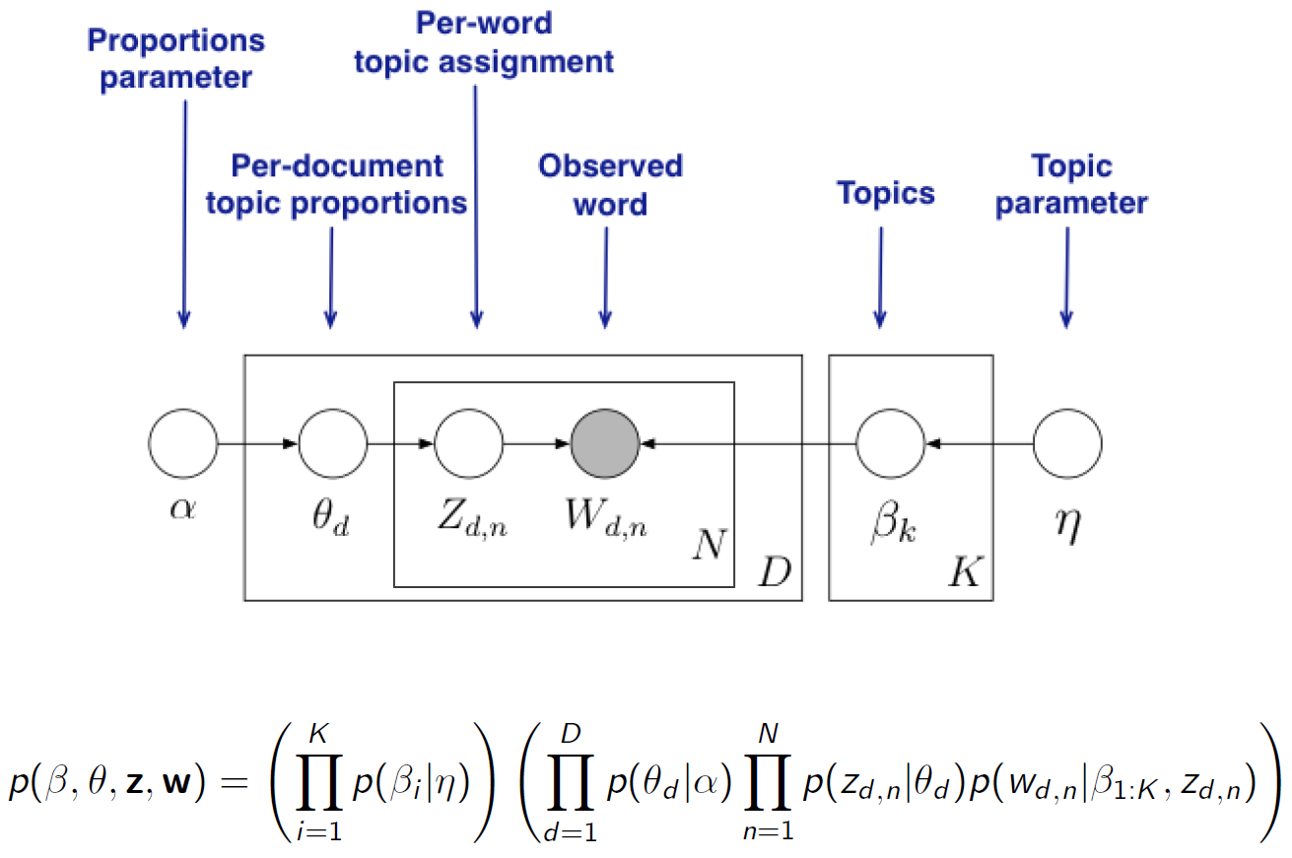
LDA as graphical model

Slide 36
LDA as graphical model
from joint distribution P(β,θ,z,w), posterior distribution can be inferred: P(β,θ,z|w)
i.e. Topic model inference resulting in
  assignments zd,n of topics to all words in each document
  distribution of topics θd in each document
  distribution of terms βk in each of the K topics
results can be used for information retrieval, time series, collection filtering, ...

Slide 37
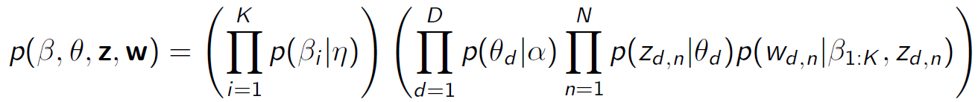
Inference
Analytically intractable → approximate solution needed
Hard task in topic modeling: computationally tractable inference on model parameters; e.g.
  Gibbs Sampling
  Variational inference
Good news: there are some fast and reliable implementations, that do the math for you :)
Crucial parameters influencing model outcomes:
  K – number of topics to be inferred
  α – prior for topic–document distributions
  η – prior for term–topic distributions
Inference is based on sampling → results are not entirely deterministic

Slide 38
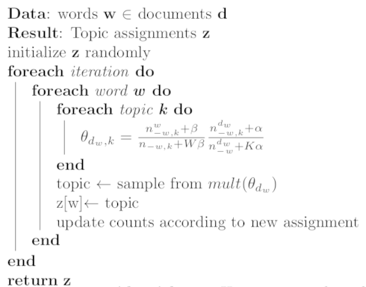
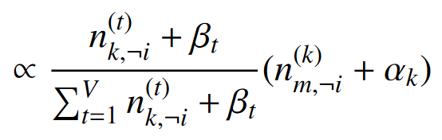
Inference – Gibbs Sampling

Slide 39
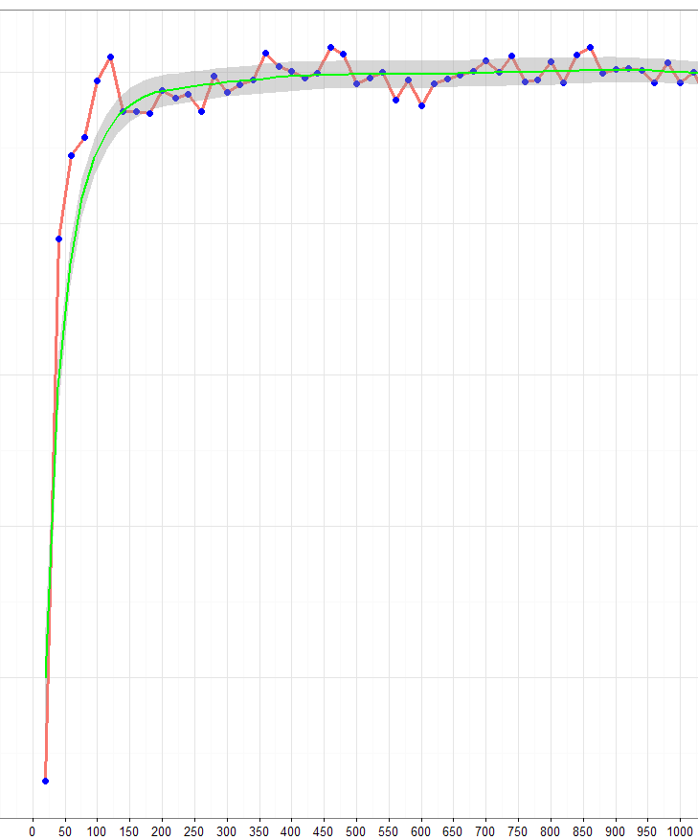
Inference – Gibbs Sampling
More interations = better likelihood of the model
Optimum almost reached at 200 – 300 iterations – This is called „burnin“ of the sampler
Likelihood does implicate the quality of the model for your research – it is an optimum w.r.t. the model assumptions
Rule of thumb: 1000 – 2000 iterations

Slide 40
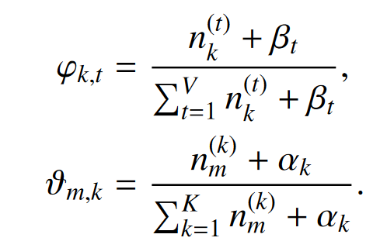
Inference – Gibbs Sampling
Gibbs algorithm samples assignments for each word
!!! Sometimes β is referenced as Φ because of the hyperparameters redundant name.
Samples must be converted to parameters θ and β by accuiring the statistics from the assigments.

Slide 41
Inference
2 mutually exclusive goals of inference process
  assign terms to as little as possible topics in one document
  assign high probability to as little as possible terms in one topic
interdependency:
  assign all terms in one document to one topic only → missing 2. goal
  assigning high probability to few terms in each topic → missing 1. goal
optimal alignment of these goals results in semantically coherent groups of terms and interpretable numbers of topics in documents
  θ =
0.1 | 0 | 0.5 | 0.1
0 | 0 | 0 | 0.2
0.1 | 0.3 | 0 | 0.1
0 | 0 | 0 | 0
β =
0.2 | 0.1 | 0.4 | 0.1
0.2 | 0.1 | 0.3 | 0.2
0.1 | 0.2 | 0 | 0.1
0.2 | 0.4 | 0 | 0.1
d documents
m Terms
K topics
K topics

Slide 42
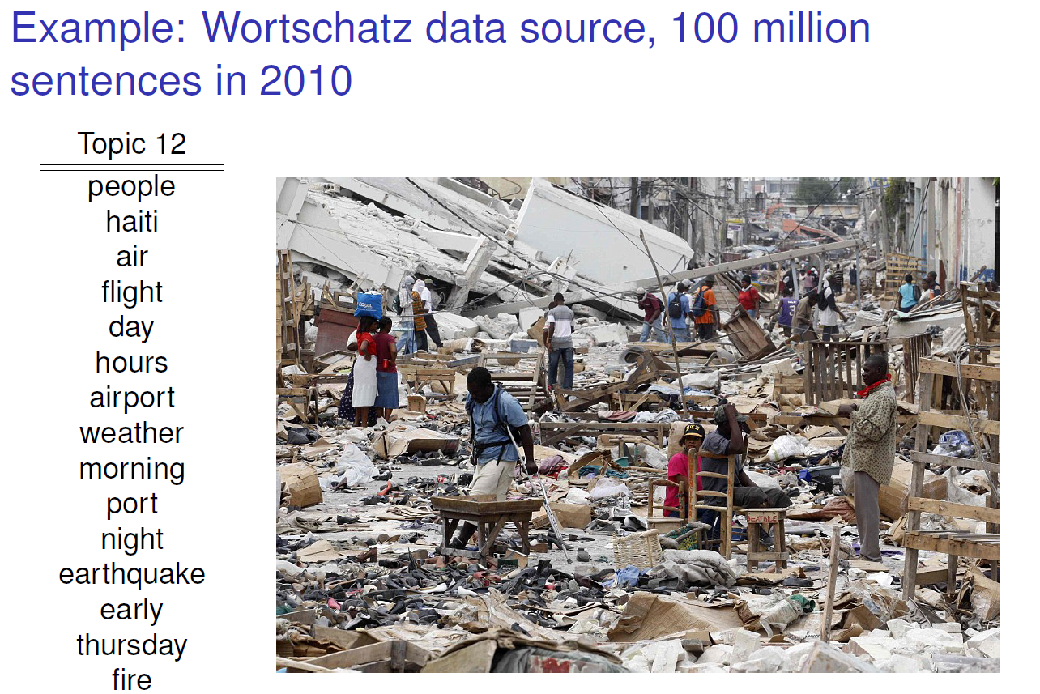
LDA examples
[Jähnichen 2015]

Slide 43
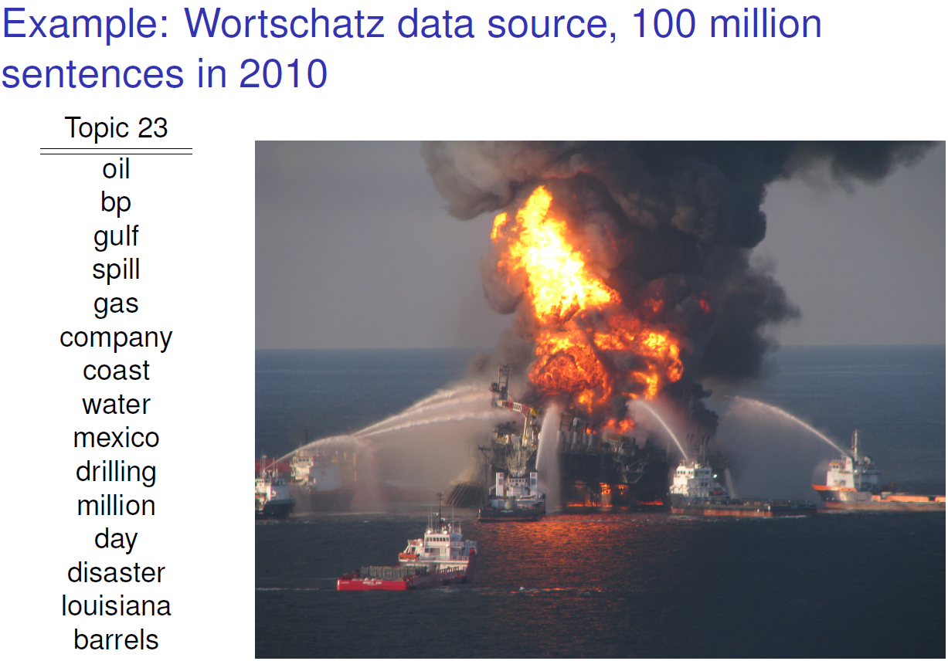
LDA examples
[Jähnichen 2015]

Slide 44
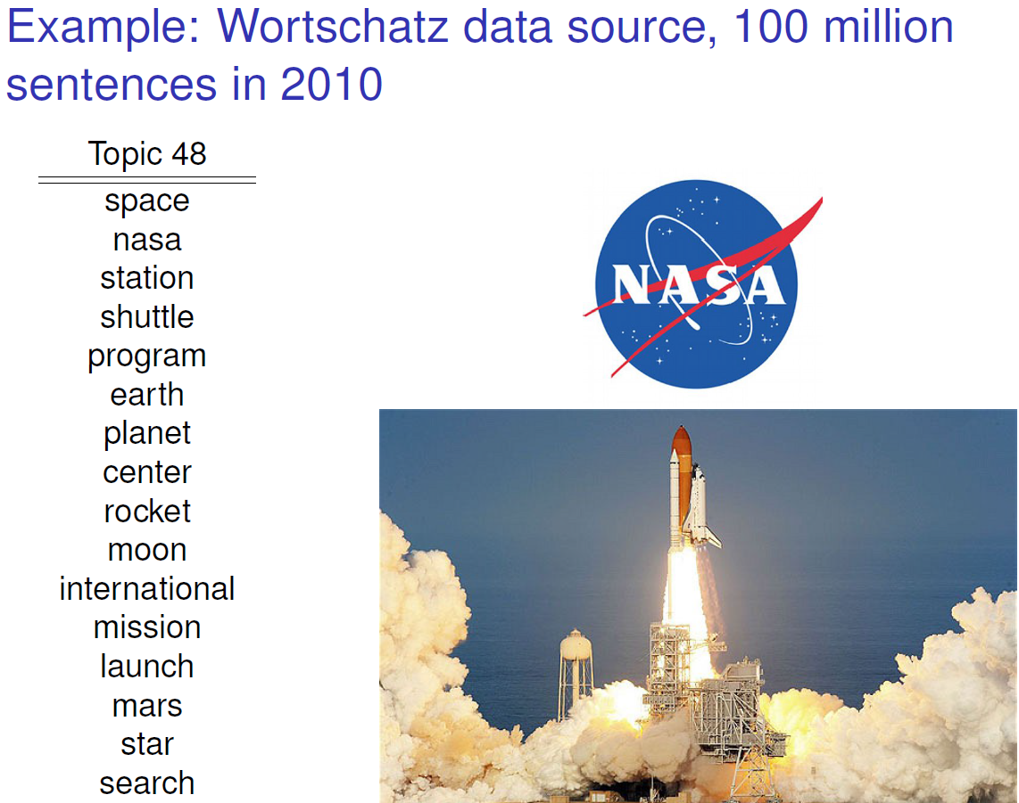
LDA examples
[Jähnichen 2015]

Slide 45
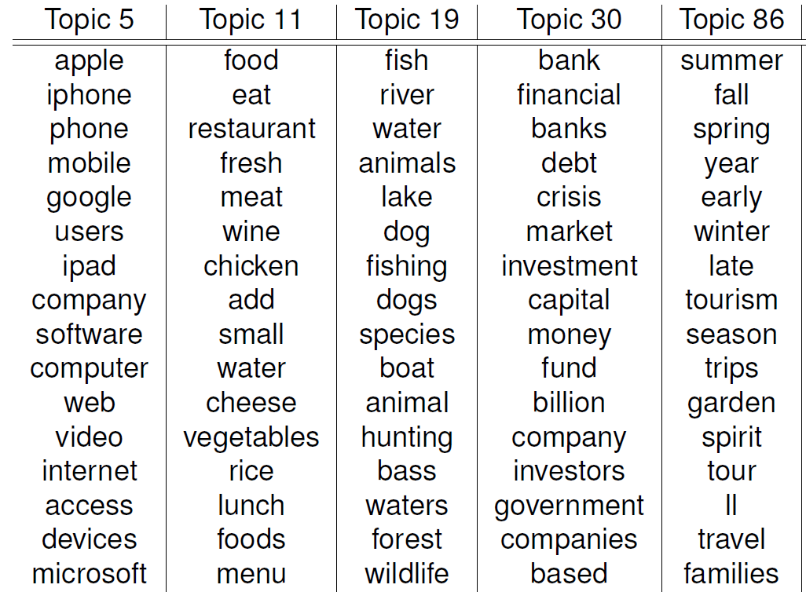
LDA examples
[Jähnichen 2015]

Slide 46
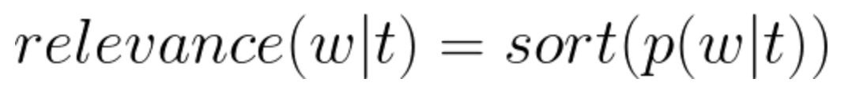
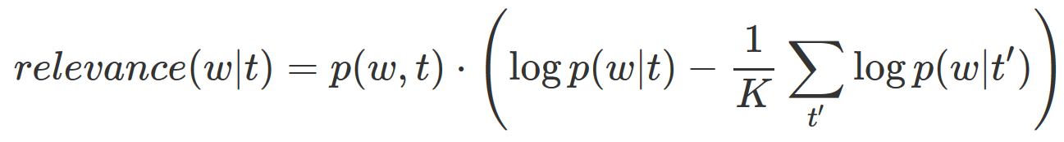
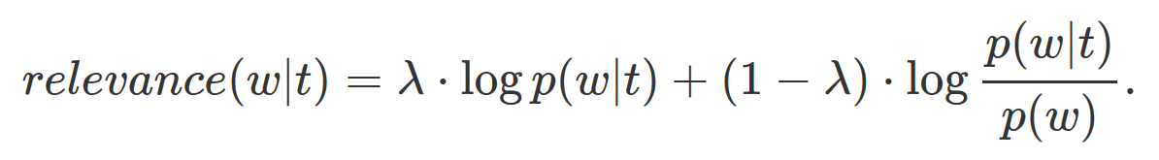
Sorting Terms
Standard Term Scoring
Scoring by Chang, J., Chang, M.J.: Package “lda”. Citeseer (2010).
Scoring by Sievert, C., Shirley, K.E.: LDAvis: A method for visualizing and interpreting topics. In: Proceedings of the workshop on interactive language learning, visualization, and interfaces. pp. 63–70 (2014).

Slide 47
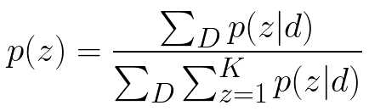
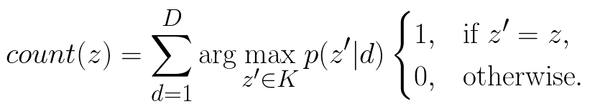
Sorting Topics
1. Approach: We sort the topics by their probability among the whole collection:
2. Approach: We count how often a topic appears as the primary topic within the documents. This method is called Rank-1.

Slide 48
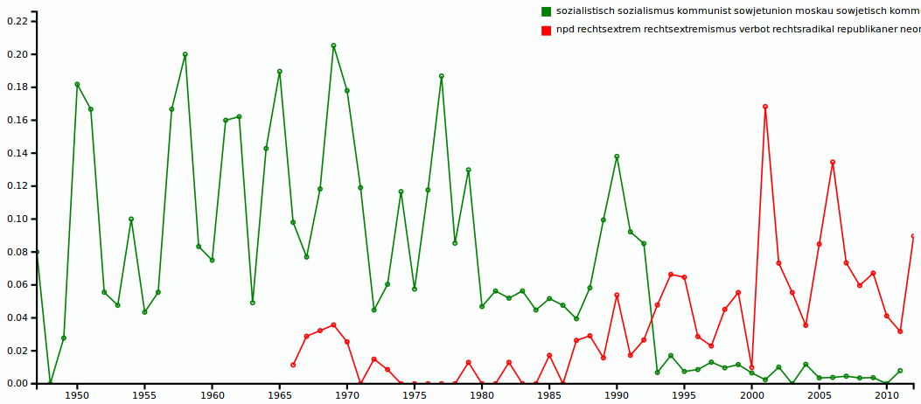
LDA examples
Time series: frequencies (relative to collection size) of documents containing
minimum 25% share of topic k (θd,k > 0.25)

Slide 49
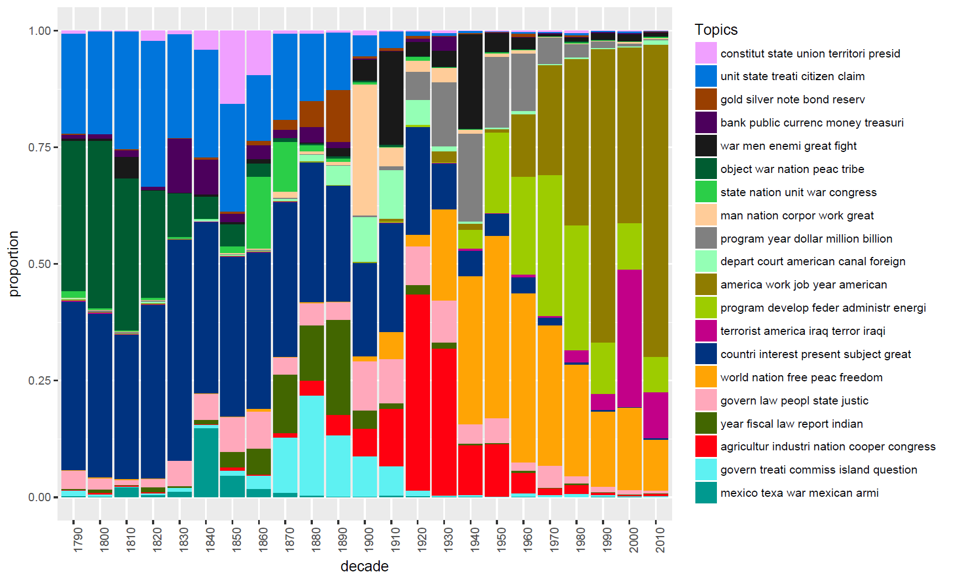
LDA examples

Slide 50
Applying topic models in CA
Topic models can be employed to
  split collections into thematic clusters
  identify documents related to certain topics
  track topic quantities over time (aggregation of document topic probabilities)
  identify similar documents based on similarity of topic distributions rather than term frequencies (cp. k-means on DTM)
  identify relevant vocabulary within a collection
Analysts need to
  choose appropriate K
  interprete resulting topics
  eventually optimize mode parameters (α, η priors)
  incorporate result data into their workflows

Slide 51
Possible alterations
Filter POS-Types: Concentrate on NN(S) / NNP(S)
Add extra vocabulary
  time stamps, categories, dictionary terms, onthology categoritzation
Initialize to predefined assignments – forced topic id‘s for words
  seeded initialization
  initialization by co-occurrence clusters of words
Problem: Inner document statistics are dependent on empirical data within the document - Short documents cannot be modelled very well
  Twitter: Try to concat tweets of the same user or hashtag to longer artificial documents – depends on the intendet topical structures

